Slide 1

Which Model Leaves
the Last Fingerprint?
ChatGPT
Claude
Stylometric Attribution Survival
Under LLM-Based Rewriting Pressure
Gemini
Grok
I.H.P.H. Dulshan
Student No: 29315
MIS — Batch 22.2
NSBM Green University
Supervisor: [Supervisor Name]
Final Year Research Project | February 2026
Notes:
1

Slide 2
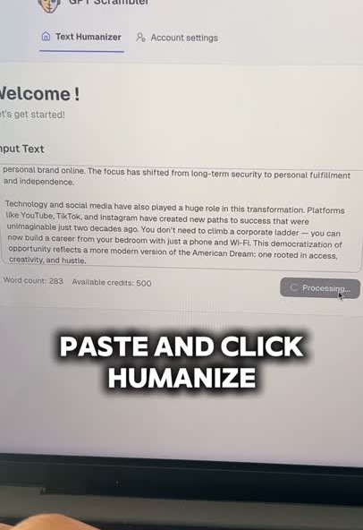
The Problem
Why can't institutions identify which AI model generated a student's work?
0
Public benchmarks
including Grok
4
100%
Major LLMs active in 2025 —
only 3 studied
Non-agreement when Grok
tested unseen (Ye et al., 2025)
I.H.P.H. Dulshan | Reg No: 29315 | MIS — Batch 22.2 | NSBM Green University
Notes:
2

Slide 3
Four Research Gaps This Study Closes
Each gap is a falsifiable absence of evidence — not a conceptual critique
Gap 1
Gap 2
Grok Absent from All Benchmarks
Attribution Degradation Unstudied
RAID, M4, DAIGT — every major dataset excludes Grok. Ye et al. (2025): classifiers trained on other 3 models achieve 0% on Grok. The gap is architectural, not marginal.
Krishna et al. (2023) & Zhang et al. (2025) measure detection degradation only. No study measures whether inter-model attribution — a harder 4-class problem — survives rewriting.
Gap 3
Gap 4
Rewriting Tools Don't Reflect 2025
No Feature Survival Analysis Exists
All existing studies use T5 paraphrasers (parrot, DIPPER). Students in 2025 use instruction-following LLMs. Degradation estimates from T5 tools are not generalisable to current student behaviour.
Even if accuracy degrades, some features may survive rewriting. No attribution study has conducted SHAP-based feature survival analysis to identify which are edit-resistant.
I.H.P.H. Dulshan | Reg No: 29315 | MIS — Batch 22.2 | NSBM Green University
Notes:
3

Slide 4
Research Questions
Four questions — each closing a specific identified gap
RQ1
What is the baseline inter-model attribution accuracy across ChatGPT, Claude, Gemini, and Grok using combined stylometric and PCA-compressed SentenceTransformer features, evaluated through 5-fold stratified cross-validation?
Closes Gap 1
RQ2
How does LLM-based rewriting affect attribution accuracy at light (~40%) and heavy (~65%) edit levels, and at what threshold does attribution fall below 25% chance-level performance?
Closes Gap 2
RQ3
Which of the 8 stylometric features retain greatest discriminative power under rewriting (SHAP survival)? Does overall semantic signal survive at comparable levels? — Two distinct interpretability levels maintained.
Closes Gap 4
RQ4
Does a combined stylometric + PCA-semantic feature set outperform either type alone, using XGBoost as constant baseline classifier to isolate feature-type effects from classifier effects?
Closes Gap 4
I.H.P.H. Dulshan | Reg No: 29315 | MIS — Batch 22.2 | NSBM Green University
Notes:
4

Slide 5
Related Works — What Exists vs What's Missing
Every prior study fails on at least one of the four gaps
Study | Grok? | Rewriting? | Attribution? | Rewriter
RAID (Chen et al., 2024) | ✗ | ✗ | ✗ | N/A
M4 (Wang et al., 2024) | ✗ | ✗ | ✗ | N/A
Argasinski et al. (2025) | ✗ | ✗ | Partial | N/A
Krishna et al. (2023) | ✗ | ✓ | Detection only | T5 paraphraser
Zhang et al. (2025) | ✗ | ✓ | Detection only | Adversarial T5
THIS STUDY | ✓ FIRST | ✓ YES | ✓ FIRST | LLM Llama 3.3
I.H.P.H. Dulshan | Reg No: 29315 | MIS — Batch 22.2 | NSBM Green University
Notes:
5

Slide 6
Dataset Construction — 3,600 Samples
300 samples × 4 models × 3 edit conditions | 4 domains balanced throughout
Cond. 1
0% — Original
Cond. 2
~40% Light Rewrite
Cond. 3
~65% Heavy Rewrite
Training set
OOD test set
OOD test set
300/model
RAID benchmark:
ChatGPT, Claude, Gemini
xAI API ~$0.15 (Grok)
No rewriting applied
Llama 3.3 70B
via Groq free API
Levenshtein: 30–50%
Cosine sim ≥ 0.80*
Dual-metric gate
Llama 3.3 70B
via Groq free API
Levenshtein: 55–70%
Cosine sim ≥ 0.597*
Dual-metric gate
* Pilot thresholds empirically derived 23 Feb 2026 using Llama-generated source texts. Calibration refinement with actual target model outputs planned Month 1 before production rewriting.
I.H.P.H. Dulshan | Reg No: 29315 | MIS — Batch 22.2 | NSBM Green University
Notes:
6

Slide 7
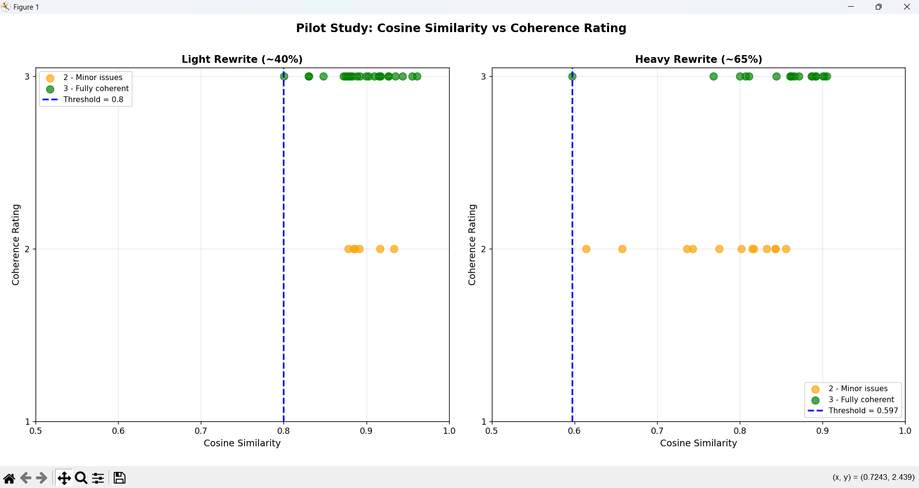
Week 1 Pilot Study — COMPLETED 23 Feb 2026
Empirically deriving quality gate thresholds — not arbitrary numbers
1
Generate 30 Source Texts
10 academic + 10 news + 10 creative
Rewritten by Llama 3.3 70B on Groq
2
Rewrite Each Twice (60 samples)
Light instruction + Heavy instruction
produced 60 rewritten samples total
3
Compute Both Metrics
Word-level Levenshtein (python-Levenshtein)
Cosine similarity (all-MiniLM-L6-v2)
4
Human Coherence Rating (Blind)
Rated 1–3 per sample before seeing
metric scores (prevents anchoring bias)
Result: Light ≥ 0.80 | Heavy ≥ 0.597 | 0 incoherent samples in 60 rewrites
Next step — Month 1: Calibration refinement with actual ChatGPT, Claude, Gemini, and Grok outputs rewritten by Llama 3.3 70B to confirm thresholds on the production data distribution
I.H.P.H. Dulshan | Reg No: 29315 | MIS — Batch 22.2 | NSBM Green University
Notes:
7

Slide 8
Methodology Pipeline
Data flows left to right through 8 stages — icons identify each process at a glance
1
Data Collection
2
LLM Rewriting
3
Quality Gate
4
Feature Extract
🗄
🤖
🔽
📐
→
→
→
RAID benchmark
(ChatGPT, Claude, Gemini)
xAI API — Grok (~$0.15)
Llama 3.3 70B
via Groq free API
2,400 samples
Levenshtein (word-level)
+ Cosine similarity
Dual-metric filter
8 stylometric features
+ all-MiniLM-L6-v2
384-d embeddings
5
PCA Reduction
6
Scale & Combine
7
Ensemble Train
8
OOD + SHAP
PCA Reduction
Before PCA
🔬
After PCA
⚖
🏋
📊
2.4:1
→
11.6:1
→
→
→
384-d → ~75 PCA
components (95% var.)
Sample ratio: 11.6:1 ✓
Independent StandardScaler
per feature group →
~83-d final vector
XGBoost + RF + MLP
Soft-voting ensemble
5-fold CV, 0% data only
Evaluate on rewritten
data. SHAP feature
survival analysis
samples/feature
samples/feature
Overfitting risk eliminated
I.H.P.H. Dulshan | Reg No: 29315 | MIS — Batch 22.2 | NSBM Green University

Slide 9
Ablation Study — What Each Comparison Isolates
XGBoost constant across configs 1–3: any accuracy difference = feature type, not classifier
Config 1
Config 2
Config 3
Config 4 ★
Stylometric Only
PCA Semantic Only
Combined
Ensemble — Primary
Features:
Features:
Features:
Features:
8 stylometric features
(independently scaled)
~75 PCA components
from all-MiniLM-L6-v2
(independently scaled)
~83 dimensions total
(8 stylo + ~75 PCA)
independently scaled
XGBoost + RF + MLP
soft vote on ~83
combined features
Isolates:
Isolates:
Isolates:
Isolates:
Do surface-level patterns
carry attribution signal alone?
Does compressed semantic
representation alone suffice?
Does combining both types
beat either alone? (RQ4)
Does multi-classifier
voting add benefit
beyond Config 3?
Feature type effect
Feature type effect
Feature type effect
Classifier architecture
I.H.P.H. Dulshan | Reg No: 29315 | MIS — Batch 22.2 | NSBM Green University
Notes:
9

Slide 10
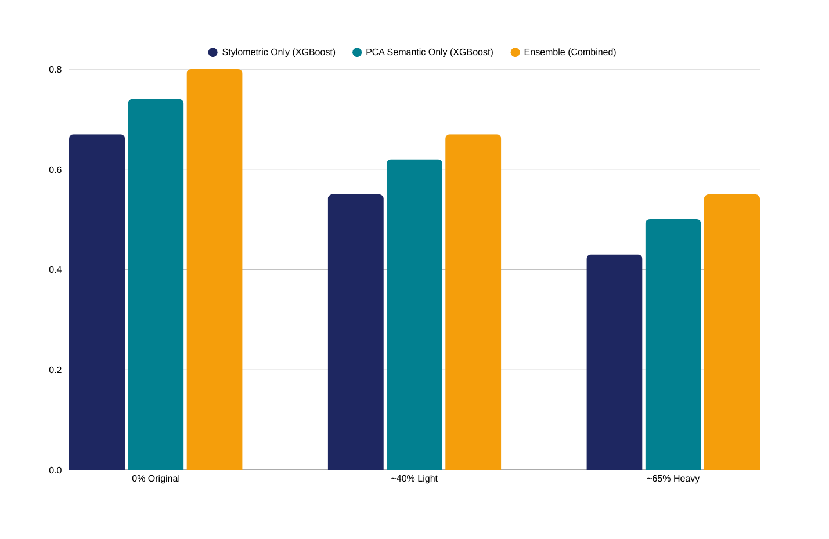
Expected Results — Projected F1 by Edit Condition
Planning estimates from comparable studies — actual values determined empirically
Scenario A
Attribution Survives Light
F1 ≥ 0.65 at ~40%: fingerprints robust to light rewriting.
Scenario B
Fails at Heavy Rewrite
F1 < 0.50 at ~65%: heavy rewriting anonymises model identity.
Scenario C
Grok Degrades Differently
Per-model recall shows Grok behaves distinctly — novel either direction.
Scenario D
Null Result
All models degrade equally — itself a valid, publishable finding.
I.H.P.H. Dulshan | Reg No: 29315 | MIS — Batch 22.2 | NSBM Green University
Notes:
10

Slide 11
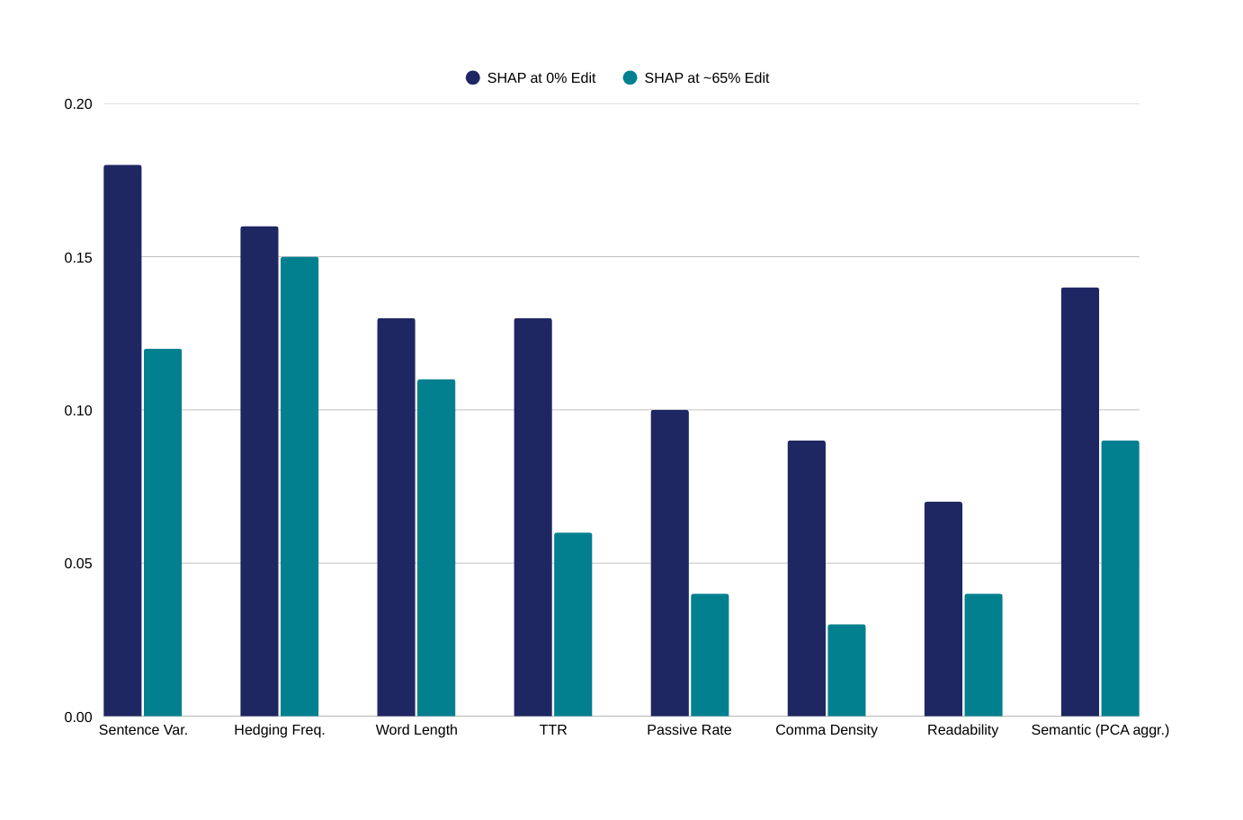
SHAP Feature Survival Analysis
Two interpretability levels — named stylometric features vs aggregate PCA semantic signal
8 Stylometric Features (Interpretable)
SHAP values reported per named feature.
Granular design guidance for future tools:
Edit-resistant features → weight more heavily.
PCA Semantic (Aggregate only)
PCA components = linear combos of 384 dims.
NOT interpreted individually.
Only aggregate importance reported.
Practical Outcome
Future attribution tools should prioritise
whichever stylometric features are most
edit-resistant per SHAP survival curves.
📌 REPLACE with actual SHAP values from TreeExplainer after analysis. Chart above is illustrative only.
I.H.P.H. Dulshan | Reg No: 29315 | MIS — Batch 22.2 | NSBM Green University
Notes:
11

Slide 12
Novel Contributions
FIRST
FIRST
NEW
First Study Including Grok
First Attribution Degradation Study
Empirical Dual-Metric Quality Gate
Every existing benchmark excludes Grok. First inter-model attribution evaluation across all four major commercial LLMs.
Prior work measures detection degradation only. First measurement of inter-model attribution degradation under LLM-based rewriting.
Pilot-validated Levenshtein + cosine gate. Calibration refinement with target model outputs planned Month 1.
NEW
NEW
CLEAN
PCA-Corrected Feature Pipeline
Two-Level SHAP Survival Analysis
Unambiguous Ablation Design
all-MiniLM-L6-v2 replaces RoBERTa [CLS]. PCA → ~83-d vector. Sample ratio 11.6:1 — overfitting risk eliminated.
Granular stylometric guidance + aggregate PCA semantic signal retention. Interpretability scope explicitly maintained.
XGBoost constant across feature conditions isolates feature effects from classifier architecture effects cleanly.
I.H.P.H. Dulshan | Reg No: 29315 | MIS — Batch 22.2 | NSBM Green University
Notes:
12

Slide 13
Feasibility & Risk Register
All risks have documented overcoming strategies — no single point of failure
Hardware & Tools | Total Cost: ~$0.15
Risk Register — All Have Documented Overcoming Strategies
✓ 4 GB GPU — all-MiniLM-L6-v2 extraction (~30 min, 80MB model)
High
xAI API cost increase
✓ 24 GB RAM — all CPU ops, training, SHAP, PCA, ablation
Fix: Semi-automated manual collection (pyautogui). 15/day, $0 fallback.
✓ Groq API (free) — Llama 3.3 70B rewriting (2,400 samples)
Med
Pilot mis-calibrated (self-rewriting flaw)
Fix: Month 1 calibration refinement with actual target model outputs — before production rewriting.
✓ xAI API ($0.15) — 300 Grok samples collected
Med
Groq rate limit reached
✓ scikit-learn, XGBoost, SHAP, spaCy — all free & open source
Fix: HuggingFace Inference API + Mistral-7B as documented backup rewriter.
Low
PCA component count suboptimal
7-Month Timeline
Fix: Adjust variance target (90–99%). Report final count and cumulative variance in results.
M1: Data collection + calibration refinement [PLANNED]
Med
Quality gate rejects too many samples
M2: LLM rewriting + quality gate filtering
Fix: 50-sample reserve pool. Relax cosine floor by 0.02 if depleted; document deviation.
M3: Feature extraction + PCA + thesis writing
M4: Training + OOD evaluation
Null result
M5: SHAP + visualisations + Grok analysis
Low
M6: Full thesis draft + supervisor review
Fix: Valid publishable finding. SHAP survival analysis remains fully actionable.
M7: Revisions + submission + presentation
I.H.P.H. Dulshan | Reg No: 29315 | MIS — Batch 22.2 | NSBM Green University
Notes:
13

Slide 14
Limitations & Scope
Acknowledged transparently — each with a clear future research direction
LLM Rewriting ≠ Commercial Humanisers
Pilot Self-Rewriting Flaw
PCA Interpretability
Tests LLM-based rewriting only. StealthWriter/Undetectable.ai use perplexity injection and burstiness manipulation not captured here. Clearly out of scope — future work.
Pilot used Llama-generated source texts. Calibration refinement with actual ChatGPT/Claude/Gemini/Grok outputs planned Month 1 before production rewriting begins.
PCA components = linear combinations of 384 embedding dims. Not directly interpretable. Individual PCA SHAP values not reported as design guidance — aggregate semantic signal only.
Single Rewriting Model
ChatGPT Version Boundary
Sample Size
All rewrites use Llama 3.3 70B. Different rewriting LLMs may produce different degradation profiles. Multi-rewriter experiment is future work.
RAID contains GPT-3.5/4, not GPT-4o. Fingerprints of newer versions may differ. Documented per sample — GPT-4o comparison is future work.
300/model appropriate for undergraduate study with 5-fold CV. Results indicative — replication at n ≥ 1,000/model recommended for follow-up research.
I.H.P.H. Dulshan | Reg No: 29315 | MIS — Batch 22.2 | NSBM Green University
Notes:
14

Slide 15

Which Model Leaves the Last Fingerprint?
Thank You for Your Attention
✓ First inter-model attribution study including Grok across all four major commercial LLMs
✓ First measurement of attribution degradation under LLM-based rewriting
✓ Pilot-validated dual-metric quality gate — empirically derived, not arbitrary
✓ PCA-corrected pipeline — all-MiniLM-L6-v2 + ~83-d vector, sample ratio 11.6:1
✓ Two-level SHAP survival — granular stylometric + aggregate PCA semantic
Questions & Discussion Welcome
I.H.P.H. Dulshan | Reg No: 29315 | MIS — Batch 22.2 | NSBM Green University
Notes:
15

